Slide 1
Identity (Azure+O365)
Bill Hughes
Concurrency

Slide 2
Speaker note: Please remember to download the video (slides 5/6) so you don’t depend on network bandwidth during the presentation

Slide 3

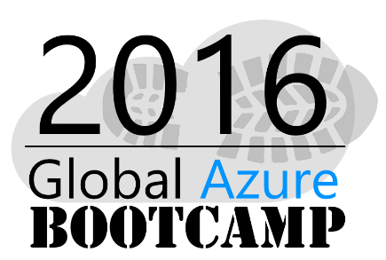
Bill Hughes
Sr. Systems Engineer
Twitter: @_billhughes
LinkedIn: https://www.linkedin.com/in/billhughes3
Email: bhughes@concurrency.com
Web: www.concurrency.com

Slide 4
Agenda
Why our cloud
Authentication 101, getting things done
How to use Office 365 and Azure on your app
(+ with access control)

Slide 5
A story about two organizations...

Slide 6
Speaker note: Video - High quality: http://video.ch9.ms/ch9/79da/bec2e49e-ce8c-49d0-bc63-fc3cdb3079da/AzureO365Identity_high.mp4 Video - Mid quality: http://video.ch9.ms/ch9/79da/bec2e49e-ce8c-49d0-bc63-fc3cdb3079da/AzureO365Identity_mid.mp4 (optionally you can un-hide the next few slides and walk the story without the video)

Slide 7


Slide 8
A story about two organizations...

Slide 9
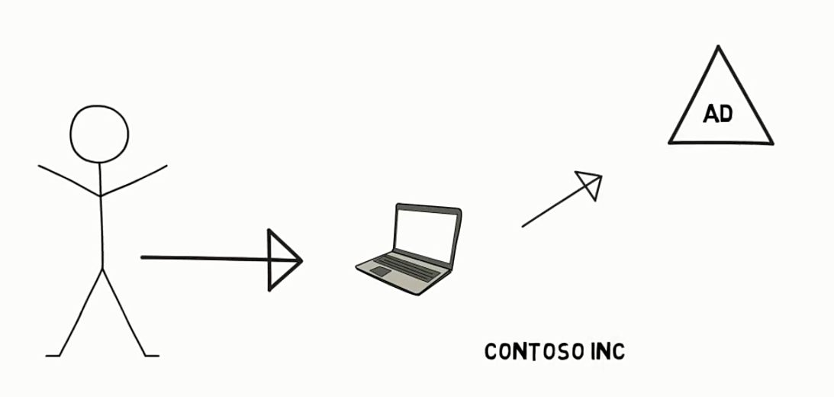

Slide 10
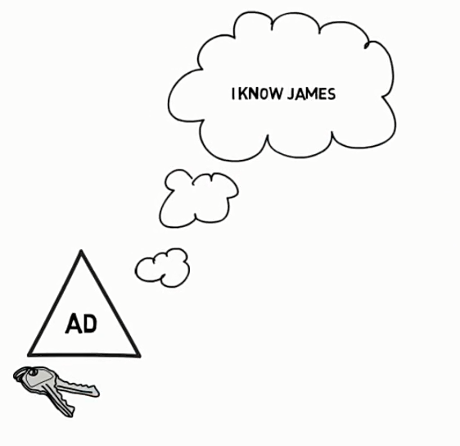


Slide 11
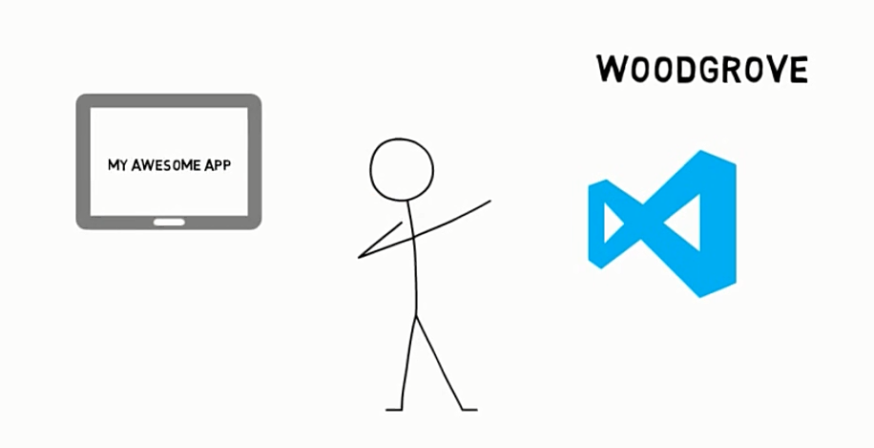

Slide 12
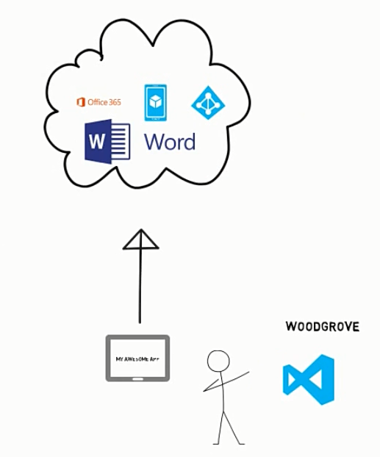

Slide 13
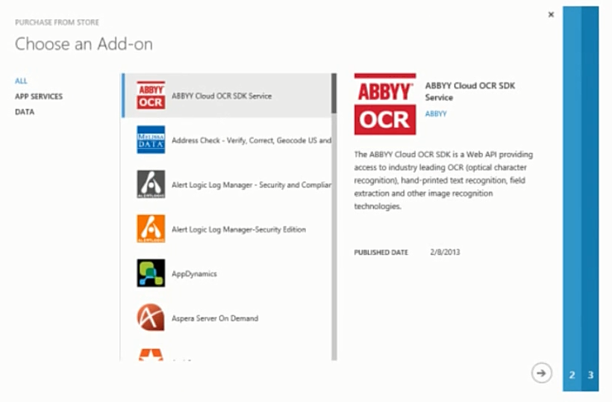

Slide 14
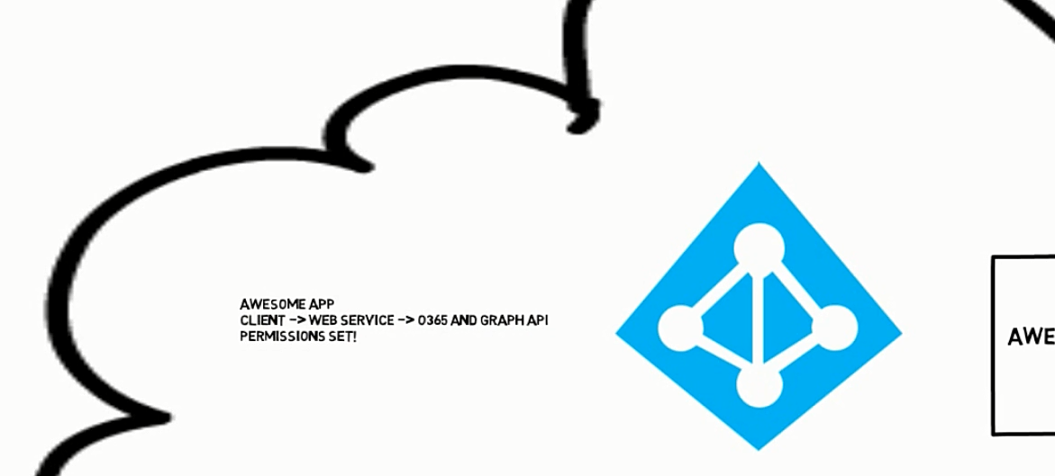

Slide 15
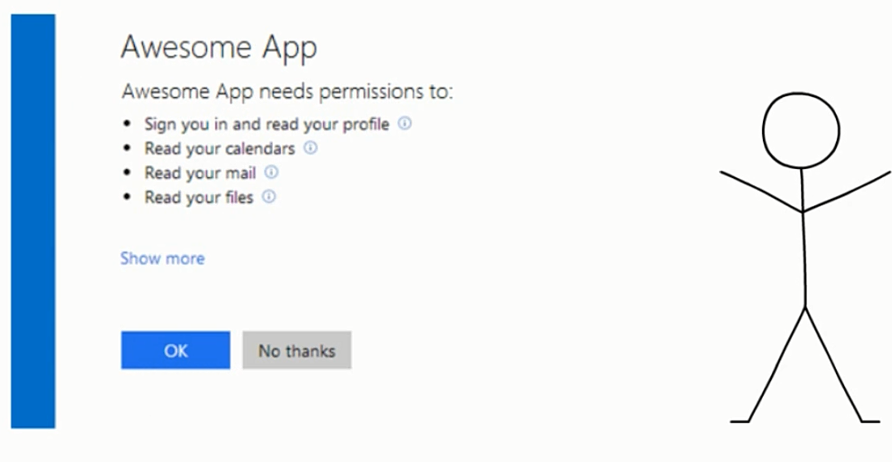

Slide 16
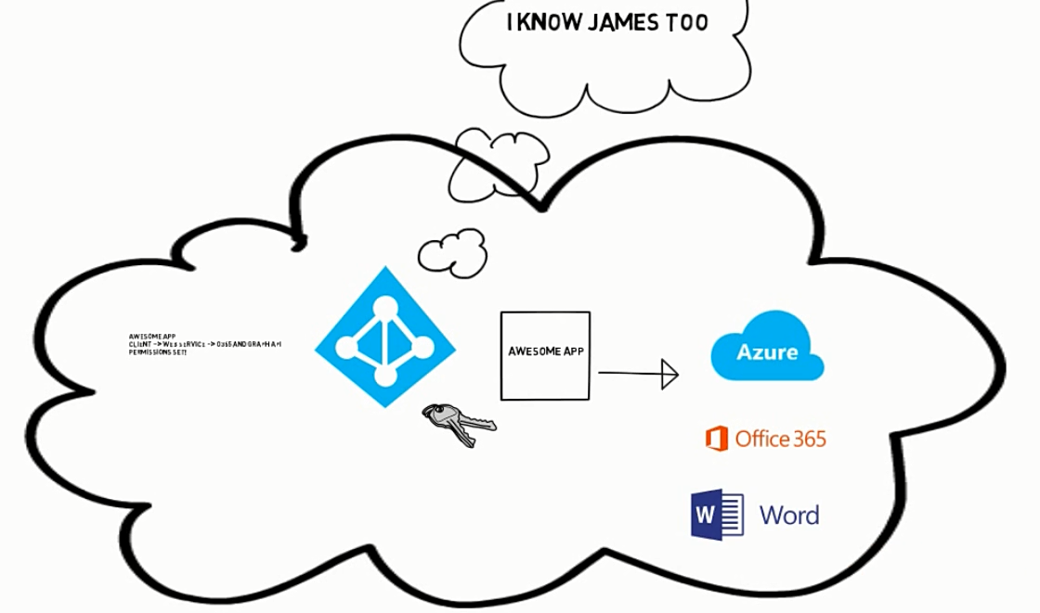

Slide 17
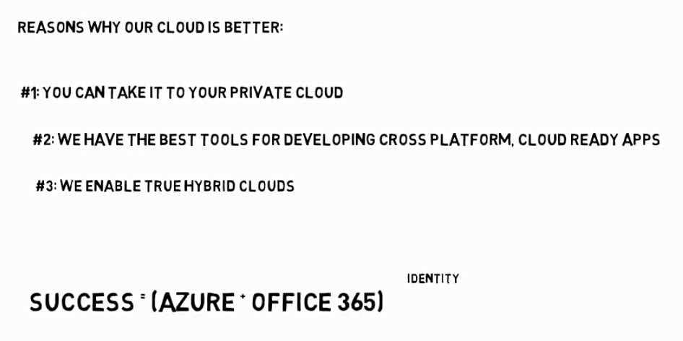

Slide 18
A better cloud
From private
or hybrid and IaaS
to full PaaS/SaaS

Slide 19
Azure + o365
Fully flexible: Private, on premises, hybrid or cloud
The power of o365: Leverage Office, SharePoint and Exchange Online as your application building blocks
Identity is the glue that makes all of that possible

Slide 20
You
Your identity goes with you
3rd party clouds/hosting
Azure AD
Active Directory
PCs and devices

Slide 21
So what is Azure AD?

Slide 22
What is Azure Active Directory?
A comprehensive identity and access management cloud solution for your employees, partners, and customers.
It combines directory services, advanced identity governance, application access management, and a rich standards-based platform for developers.
B2E
B2B
B2C

Slide 23


Identity as the core
Simple connection
Windows Server
Active Directory
Other directories
Self-service
Single sign-on
Azure
SaaS
Public
cloud
On-premises
Microsoft Azure Active Directory
Cloud
Notes:
Microsoft has a solution for this
[Click] Traditional identity and access management solutions providing sing-sign on to on-premises applications and directory services such as Active Directory and others are used from the vast majority of organizations and huge investments were made to deploy and maintain them. These solutions are perfect for the on-premises world.
[Click] Now, as we have discussed, there are new pressing requirements to provide the same experience to cloud applications hosted in any public cloud.
[Click] Azure Active Directory can be the solution to this new challenge by extending the reach of on-premises identities to the cloud in a secure and efficient way.
[Click] In order to do that, one simple connection is needed from on-premises directories to Azure AD.
[Click] and everything else will be handled by Azure AD. Secure single sign-on to thousands of SaaS applications hosted in any cloud by using the same credentials that exist on-premises
[Click] And we don’t forget the users. Azure AD provides Self-service capabilities and easy access to all the application, consumer or business, they need.
in the cloud but on-premises too (Application Proxy)

Slide 24
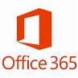
A Springboard for Web Apps
Single Sing-On
Password “vaulting” and Federation
User Provisioning in some SaaS Apps
Group-based application access
Advanced security reports and alerts
Multi-Factor Authentication (MFA/2FA)
LOB
Apps
SaaS
Apps
Remote
Apps
…
Azure Application Access Panel
Identity
Security
Devices
Azure App Panel

Slide 25
Add Apps not found in the Gallery
Capture User, Password and Submit fields
Works with Vaulted or Federated credentials
Customize tile icon shows in Panel
Custom Applications

Slide 26
fdsafdsa

Slide 27
YOUR DIRECTORY ON THE CLOUD
Azure Active Directory Application Proxy
Microsoft Azure
Active Directory
A connector that auto-connects to the cloud service
https://awesomeapp-contoso.msappproxy.net/
Application Proxy
Multiple connectors can be deployed for redundancy, scale, multiple sites, and different resources
Connectors are deployed usually on corpnet next to resources
DMZ
Users connect to the cloud service that routes their traffic to resources via the connectors
Corporate network
Connector
Connector
Resource
Resource
http://awesomeapp
Resource

Slide 28
B2B: cross-organization collaboration
B2B: cross-organization collaboration
MANAGE EVERYTHING
“I need to let my partners access my company’s apps using their own credentials”
FREE
FREE
FREE
FREE
Notes:
Your employees need to collaborate with partners: Easily share data and applications with the right people in the right companies
Your Partners want simplicity No new accounts to manage, No federation to configure, No servers to install
Admins want security Control and oversight, Granular auditing and monitoring of partner access,World class security and protection
B2B collaboration
Securing identities beyond your own employees and expanding to your network of partners and contractors is critical to protecting your company data. Azure Active Directory B2B collaboration as additional functionality available in all Azure AD editions, provides simplified management and security for partner and other external user access to your in-house resources using Azure AD as the control plane. This includes access to popular cloud applications such as Salesforce, Dropbox, Workday, and of course Office 365, in addition to mobile, cloud, and on-premises claims-aware applications.
B2B collaboration improves security, as partners manage their own accounts and enterprises can apply security policies to partner identities access.
Azure Active Directory B2B collaboration is easy to configure with simplified signup for partners of all sizes even if they don’t have their own Azure AD via an email-verified process. It is also easy to maintain with no external directories or per partner federation configurations.
Make your Azure Active Directory the center of your cross-organization collaboration.
Azure Active Directory B2B collaboration will be provided at no additional cost with all Azure AD editions.
Customer quote :
Kodak Alaris, A company that is passionate about using technology to transform organizations and improve people's lives across the planet, in Imaging and information management industry, uses Azure AD B2B collaboration to provide access to shared resources to all their partners
We needed to quickly and cost effectively stand up new IT infrastructure including extranet applications for thousands of business partners. Azure AD B2B provides a simple and secure way for partners, large and small, to use their own credentials to access Kodak Alaris systems. The Azure AD team has been an incredible partner in our re-creation of a more agile and cost-effective hybrid cloud IT infrastructure.”
Steven C. Braunschweiger, Chief Enterprise Architect

Slide 29




Connecting with consumers: Azure Active Directory B2C
Consumer identity and access management in the cloud
Cross-platform
Identity management for consumers
Superior economics
Identity experience engine
“By using Azure Active Directory B2C we were able to build a fully customized login page without having to build custom code. Additionally, with a Microsoft solution in place, we alleviated all our concerns about security, data breaches, and scalability."
- Rafael de los Santos, Head of Digital, Real Madrid
Notes:
Web site : http://www.azure.com/azuread-b2c
Vision video : aka.ms/aadb2cvideo
Pricing page: http://azure.microsoft.com/pricing/details/active-directory-b2c/
Trial page: http://azure.microsoft.com/trial/get-started-aad-b2c/
Documentation http://azure.microsoft.com/documentation/services/active-directory-b2c/
Other videos : https://channel9.msdn.com/Series/Azure-Active-Directory-Videos-Demos?sort=recent
There is a dedicated deck to B2C on infopedia

Slide 30
How do we make all of that work?
Enabling modern authentication protocols
Using great building blocks on your apps

Slide 31
Enabling modern authentication protocols

Slide 32



Modern Authentication Protocols
WS-Fed, SAML 2.0, OpenID Connect
Web application
Browser
OAuth 2.0
Native app
OAuth 2.0
OAuth 2.0
Web service API
Server app
Standard, http-based protocols for maximum platform reach
Notes:
Speaker note: The goal is not doing a deep dive on authentication protocols but present options and a high level view of what to use when

Slide 33

Modern Authentication Protocols
Browser
WS-Fed
SAML 2.0
OpenID Connect
Web
Application

Slide 34


Modern Authentication Protocols
Web
API
Native App
OAuth 2.0
OnBehalfOf
OAuth 2.0
OpenID Connect
Web
API

Slide 35
Modern Authentication Protocols
Web
APP
OAuth 2.0
client_credentials
Web
API

Slide 36

Claims about the user
Usage
Claim Type
Claim Value
Object ID
b3809430-6c28-4e43-870d-fa7d38636dcd
Tenant ID
81aabdd2-3682-48fd-9efa-2cb2fcea8557
Security
Subject
m70fSk8OdeYYyCYY6C3922lmZMz9JKCGR0P1
Name
frank@contoso.com
First Name
Frank
Display
Last Name
Miller

Slide 37
Authentication libraries
Good news: You don’t need to know these things in details
Libraries such as Azure Active Directory Authentication Library do all the plumbing for you

Slide 38
Enabling great building blocks

Slide 39
Building blocks: Azure Active Directory
Provides identity and access management for the cloud
Users, groups, applications and permissions

Slide 40
Building blocks: Graph API
REST API for Azure Active Directory
Allows programmatic access to users, groups, applications and permissions
Example: Nick creates a PowerShell script that provisions the required permissions for his application to an Azure tenant
Notes:
[click] Example

Slide 41
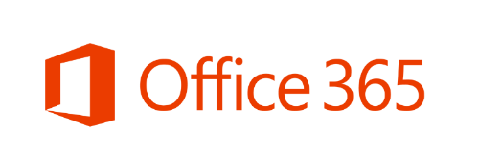
Building blocks: Office 365
The best Office productivity tools, available online
Includes REST APIs you can use from your applications
Seamless integration with Azure Active Directory
Example: An application can automatically scan e-mails from Exchange and generate a Word document with a summary, saving it on SharePoint Online
Notes:
[click] Example

Slide 42
So how do we build it?

Slide 43
For a typical Web Application

Slide 44
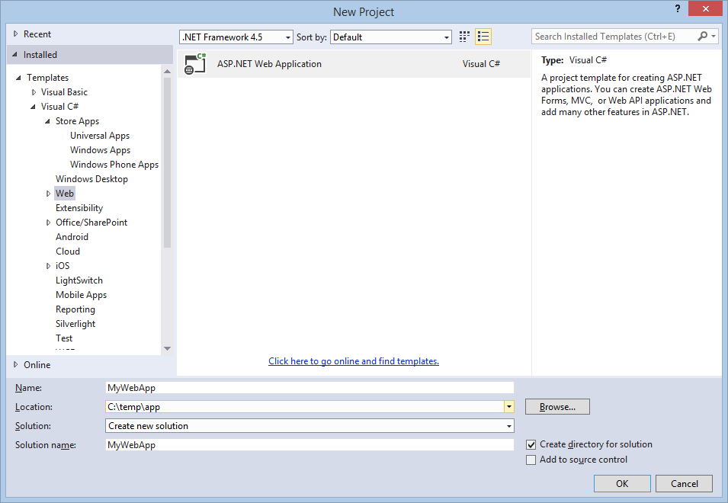
Step 1: Visual Studio, file new project

Slide 45
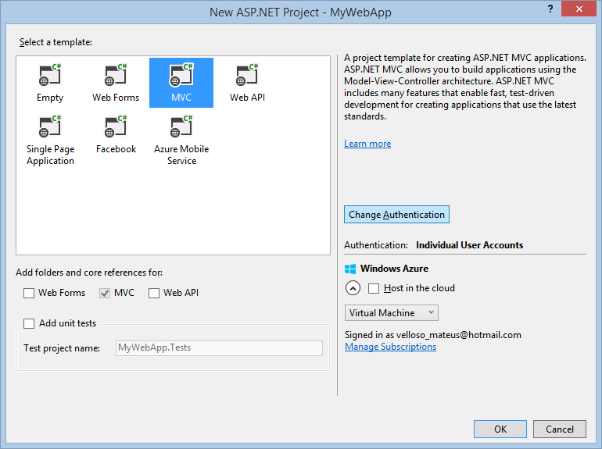
Step 2: Click “Change Authentication”

Slide 46
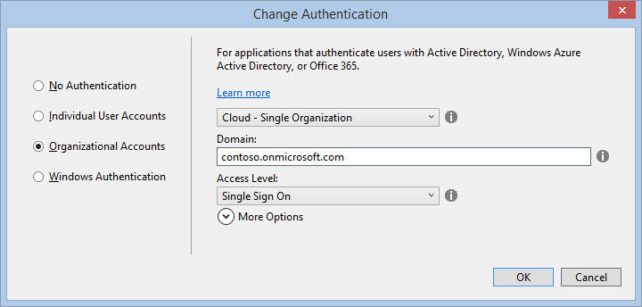
Step 3: Configure organizational account

Slide 47
What happens then:
Visual Studio configures the application permission settings for you on Azure Active Directory!
Visual Studio
App
permissions
Azure AD

Slide 48
Let’s go build an App

Slide 49
More complex scenario:
Mobile app -> mobile service -> O365

Slide 50
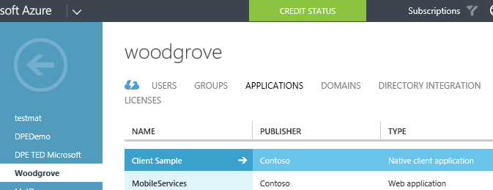


Step 1: Register your apps on Azure AD
Nick (the developer) registers two applications:
A mobile web service
A mobile client

Slide 51
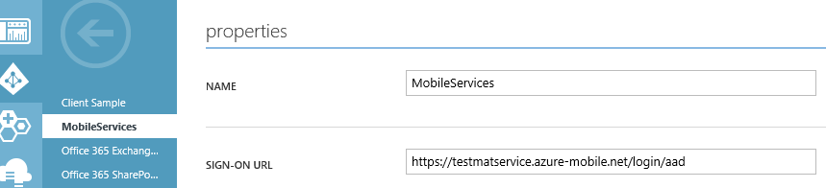
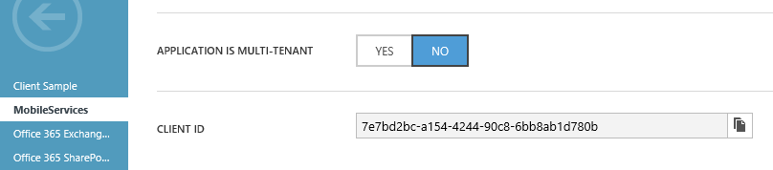
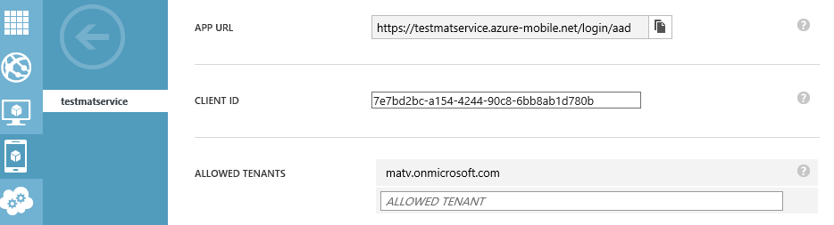
Step 2: Map the AD app to the actual web service
AD needs to know which web service the “MobileServices” app is actually referring to.

Slide 52
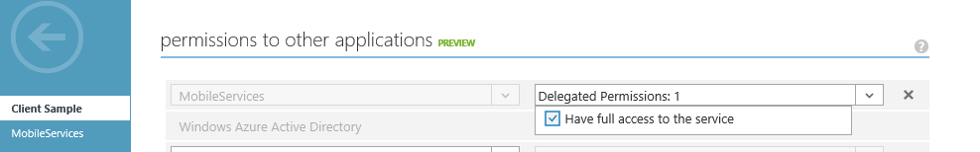
Step 3: Set permissions
The client app must be allowed to call the web service.
It is also allowed to logon to Azure Active Directory (by default)

Slide 53
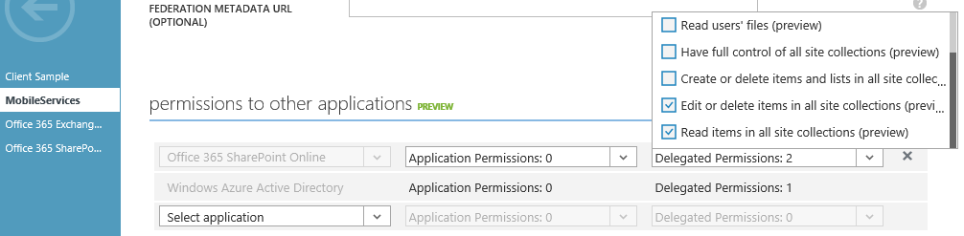
Step 3: Set permissions
And the web service is allowed to call SharePoint online and Graph API

Slide 54
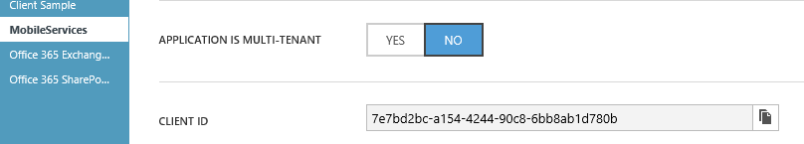

Step 4 (optional): Making an app multi tenant
Nick can make his app multi tenant, so James from Contoso Inc. could use it in his organization if the permissions were set correctly
Woodgrove
Contoso

Slide 55
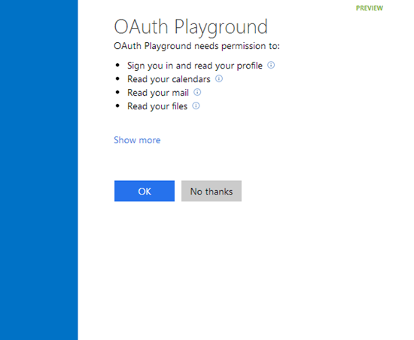
Step 5: User logs on to the app
A user logs on to the app for the first time. Consent is presented. This is basically saying:
“This is what the app will do, are you ok with it?”

Slide 56
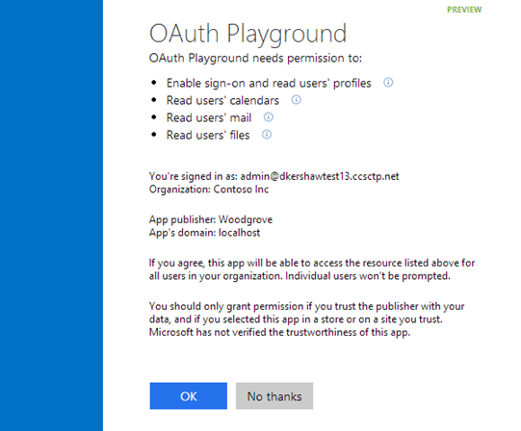
Step 5: User logs on to the app
If the user is the global admin for the Azure tenant, the consent asks if the admin wants to grant permissions for the app across all users of that organization.
admin

Slide 57
Go to app access panel: http://myapps.microsoft.com/
Step 6 (optional): What if I change my mind later?
Where users see apps they have access to
Includes apps they’ve consented to
Users can revoke consented apps

Slide 58
Implementation details
Let’s dive deeper into the Rabbit’s hole

Slide 59
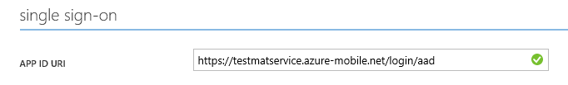
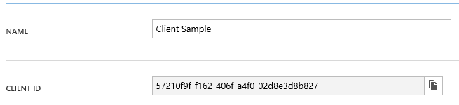

Active Directory Authentication Library (ADAL)
string clientId = "[Enter client ID as obtained from Azure Portal]";
string authority = "https://login.windows.net/[your tenant name]";
string myURI = "[Enter App ID URI of your service]";
AuthenticationContext authContext = new AuthenticationContext(authority);
AuthenticationResult result = await authContext.AcquireTokenAsync(myURI, clientId);

Slide 60
Graph API
RESTful interface to Azure Active Directory
Tenant Specific – queries are scoped to individual tenant context
Programmatic access to directory objects such as Users, Groups, Contacts, Tenant Information, Roles, Applications and Permissions
Access relationships: members, memberOf, manager, directReports
OAuth 2.0 Support
Both Client Credentials and Authorization Code flow

Slide 61
Graph API
Requests use standard HTTP methods
GET, POST, PATCH, DELETE to create, read, update, and delete
Response support JSON, XML, standard HTTP status codes
Compatible with OData V3

Slide 62
Graph API
Graph URL (static)
Tenant of interest – can be tenant’s verified domain or objectId.
Specific entity type, such as users, groups, contacts, tenantDetails, roles, applications, etc.
https://graph.windows.net/contoso.com/users?api-version=2013-04-05&$filter=state eq ‘WA’
API version – “2013-04-05” is the 1.0 version
Optional Odata query arguments: $filter, $top

Slide 63
Office 365 REST APIs
RESTful interface to Office on the cloud
File APIs for OneDrive for Business
Mail, Calendar and Contacts APIs on Exchange online
SharePoint online APIs
OAuth 2.0 Support
Example: GET ../_api/files(<file_path>)/download
Downloads a file stored on SharePoint online / OneDrive for Business
Notes:
[click] Example

Slide 64
Demo: Facilities app
Notes:
https://github.com/Azure-Readiness/MicrosoftAzureTrainingKit/tree/master/Demos/Demo-MobileServices

Slide 65
Application Model
Azure AD
Facilities App settings
+
Facilities Web Service settings
(multi tenant)
Woodgrove
Consent
Azure AD
Facilities App settings
+
Facilities Web Service settings
Contoso

Slide 66
Authentication and Authorization to Graph API
Azure Active Directory
Azure AD
1. Request JWT token
(pass input claims)
Azure AD Authentication Endpoint (OAuth)
Application
2. Return
token
REST Service
Validates token, processes request, returns data
Authorization Check
3. HTTP Request
with JWT Token
4. Return
Response and
Data

Slide 67
Hands on Lab
http://bit.ly/1TXQRVS

Slide 68
Application Walkthrough’s
https://github.com/azure-samples?query=active-directory
Some examples:
active-directory-dotnet-webapp-webapi-oauth2-useridentity
active-directory-dotnet-webapp-webapi-openidconnect
active-directory-php-graphapi-web
active-directory-node-webapi
active-directory-xamarin-android
active-directory-xamarin-ios

Slide 69
Labs on Graph API
https://github.com/azure-samples?query=graph
active-directory-dotnet-graphapi-web
active-directory-php-graphapi-web
active-directory-java-graphapi-web
active-directory-dotnet-graphapi-console

Slide 70
Q&A

Slide 71


Get started
Visit azure.microsoft.com

